Slide 1

Sonic Log Prediction
Team: The Panda
Pritesh Bhoumick

Slide 2
Workflow
TRAINING
PREDICTING
Domain knowledge applied in data preparation:
Group common log mnemonics together and not use all mnemonics as is for modelling
Handle rows for logs that cannot have negative values (eg: GR, Resistivity, Density etc.)
Convert resistivity log to log scale
Create shifted logs as per the market vertical resolutions (VR) of each log since individual logs are average log for the duration of VR
Drop outliers intelligently; ensure dropping only unnatural log values and outliers that would result from a manual detection

Slide 3
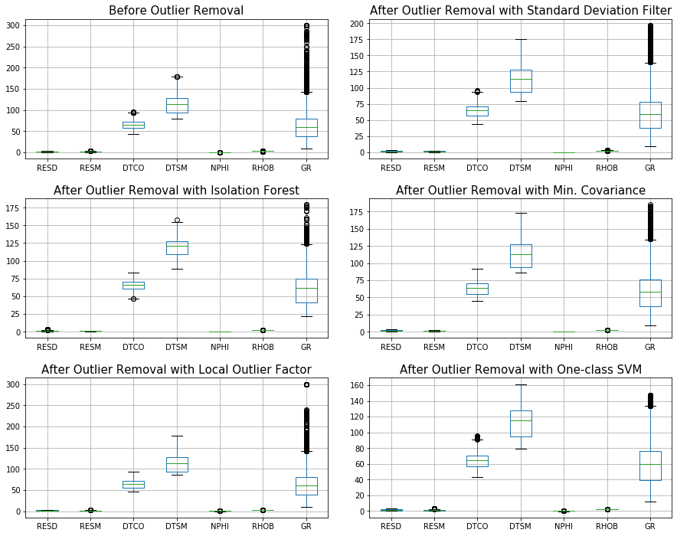

Data Preparation
Manual mapping of mnemonics to consistent naming:
No. of distinct columns in train dataset | 931
No. of distinct columns after grouping | 13 | BH, CALI, DPHI, GR, NPHI, PE, RESD, RESM, RHOB, RXO
No. of features used for modelling | 7 | GR, RESD, RESM, NPHI, RHOB, DTCO, DTSM
Outlier detection:
All the methods displayed in the plot were checked for outlier detection
One class SVM performed best on detecting outliers effectively
Data Imputation:
Data imputation was carried out for individual wells and not all wells combined
Missing data proportion was carried out on individual logs (for each well) and imputation was carried out only on logs with less than 20% missing data
Rest of the logs were not imputed to avoid improper and forced imputation
Iterative Imputer was used for imputation
Feature engineering (in ft.):
Log | Lag feature | Rolling window
RES (M&D) | 4, 6, 8 | 4, 6
GR | 2, 3, 4, 6 | 3, 5
NPHI | 1, 3, 5 | 4, 6
RHOB | 2, 3, 5 | 3, 5
DTCO | 3, 4, 5, 6, 7 | 4, 6, 8
Outlier Detection

Slide 4
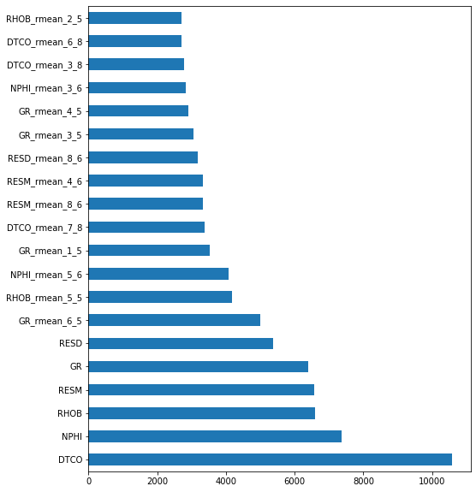
Modelling
Modelling techniques | RMSE on test data (20% of total training data)
LightGBM | 14.86
Bidirectional RNN | 17.29
Ensemble | 16.37
Hyper params | Value
colsample_bytree | 0.544
min_child_weight | 0.1
min_child_sample | 260
num_leaves | 31
reg_alpha | 7
reg_lambda | 1
subsample | 0.256
Estimators | 2346
scale_pos_weight | 2
Modelling techniques and results
Tuned hyper parameters for LightGBM model
Light GBM performed best with lowest RMSE on split train (70%), validation (10%) and test (20%) dataset
Model will ignore columns with empty row while considering each row of data for fitting
Model is robust to handle situations when one or more of the well logs are not available
Feature Importance

Slide 5
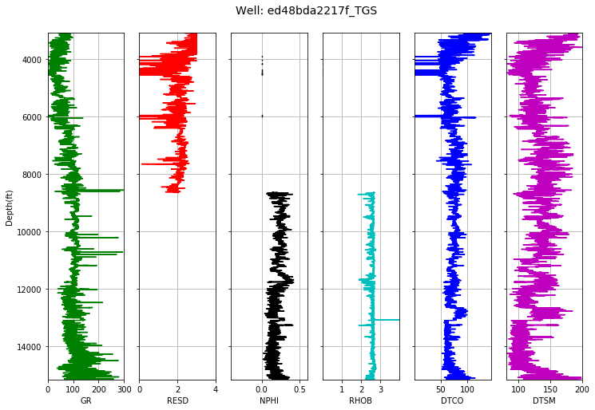
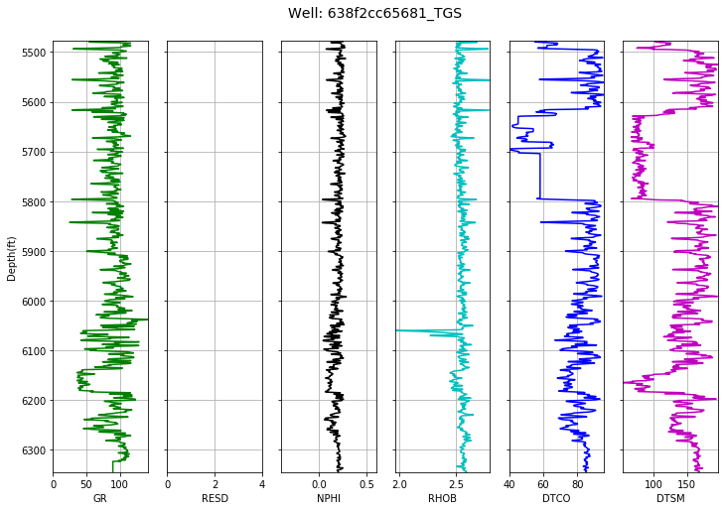
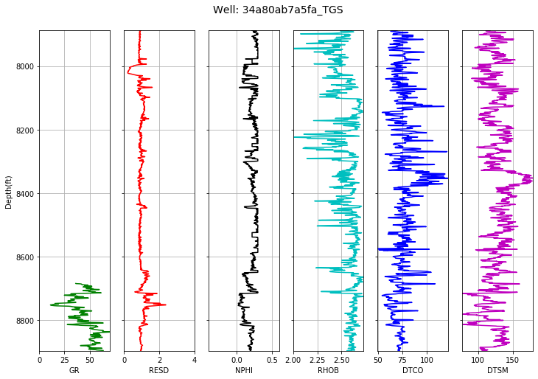
Output discussion
Performed manual log analysis of predicted logs in the 20 test well data with other input logs for sanity check
Manual interpretation suggests absence of basic well logs has minimal effect on the sonic log prediction
Minimizing RMSE does not always give the best picture on the reliability of the prediction; a manual interpretation of the logs is necessary due to the nature of the well log data in general

